Slide 1
PROCESS MANAGEMENT IN OPERATING SYSTEMS
DR . ARJUN MAGOTRA
DATE: 04-05-2023
TIME:

Slide 2
Objectives
Process Concept
Process States
Operations on Processes
Scheduling Algorithms
Interprocess Communication
Communication in Client-Server Systems

Slide 3
Process
The term “process” was first used by the operating system designers of the MULTICS system way back in 1960s.

Slide 4
Contd..
The CPU executes a large number of programs. While its main concern is the execution of user programs, the CPU is also needed for other system activities. These activities are called processes.
A process is
a program in execution.
A batch job is a process.
A time-shared user program
A system task, such as spooling

Slide 5
Program Vs Process
A program is a passive entity, while a process is an active entity.
It is known that two processes may be associated with the same program; they are nevertheless considered two separate execution sequences.

Slide 6
Contd..
In multiprogramming systems, processes are performed in a pseudo-parallelism as if each process has its own processor.
In fact, there is only one processor but it switches back and forth from process to process.
Execution of a process. includes “processor (CPU) burst” and “I/O burst” respectively.

Slide 7
Processor bound and I/O bound
Processes can be described as either:
I/O-bound process – spends more time doing I/O than computations, many short CPU bursts.
CPU-bound process – spends more time doing computations; few very long CPU bursts.

Slide 8
Process Mgmt by the OS
Process creation; Termination of the process
Controlling the progress of the process
Process Scheduling
Dispatching
Interrupt handling / Exceptional handling
Switching between the processes
Process synchronization
Interprocess communication support
Management of Process Control Blocks

Slide 9
Process Relationship
In the concurrent environment, basically processes has two relationship, competition and cooperation. In the concurrent environment, processes compete with each other for allocation of system resources to execute their instructions. In addition, a collection of related processes that collectively represent a single logical application cooperate to each other.

Slide 10
Process State
As a process executes, it changes state
New: The process is being created.
Running: Instructions are being executed.
Waiting: The process is waiting for some event to occur.
Ready: The process is waiting to be assigned to a process.
Terminated: The process has finished execution.

Slide 11
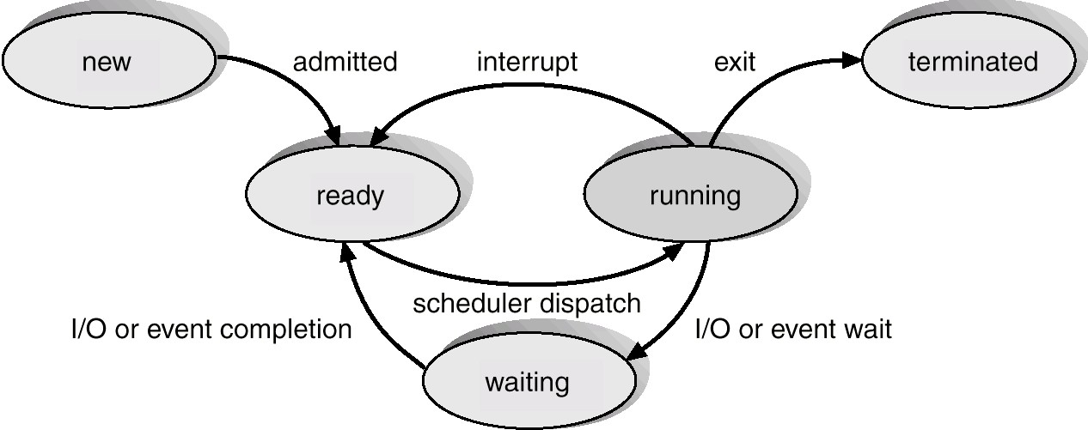
Diagram of Process State

Slide 12
Process Table or PCB
To implement the process model, the operating system maintains a table, an array of structures, called the process table or a process control block. Each entry identifies a process with information such as process state, its program counter, stack pointer, memory allocation, the status of its open files, its accounting and scheduling information. In another words, it must contain everything about the process that must be saved when the process is switched from the running state to the ready state so that it can be restarted later as if it had never been stopped.

Slide 13
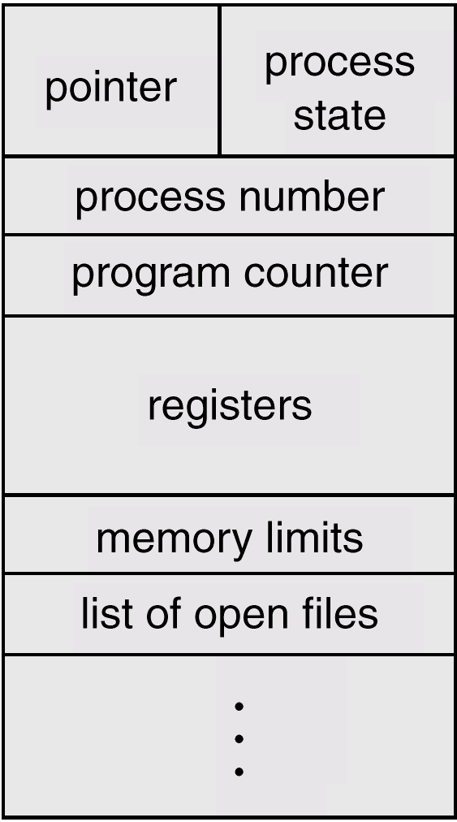
Process Control Block (PCB)

Slide 14
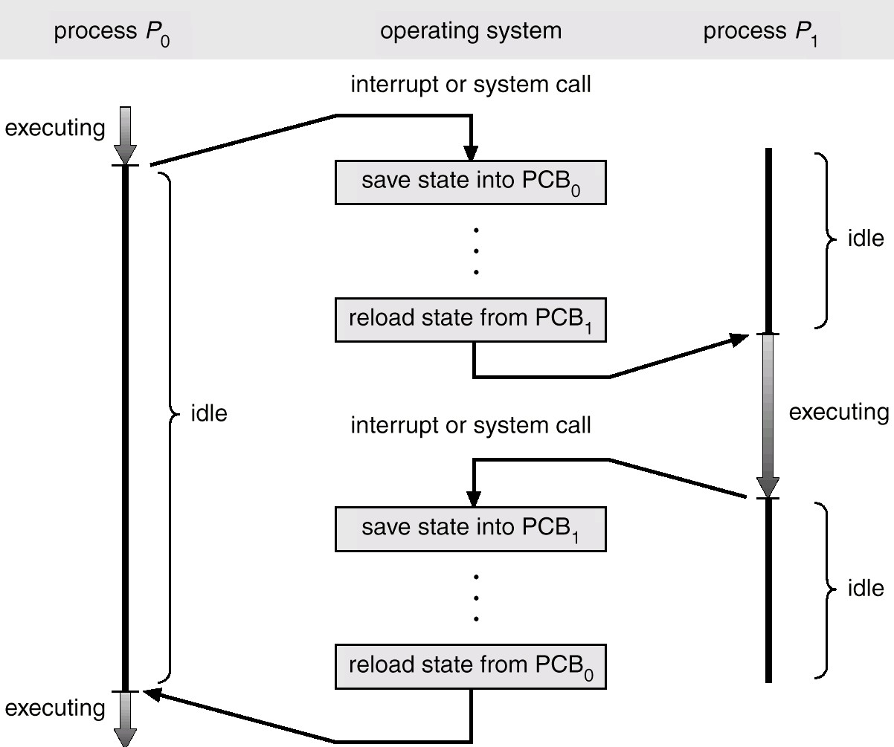
Context Switch

Slide 15
Process Scheduling Queues
Job queue – set of all processes in the system.
Ready queue – set of all processes residing in main memory, ready and waiting to execute.
Device queues – set of processes waiting for an I/O device.
Process migration between the various queues.

Slide 16
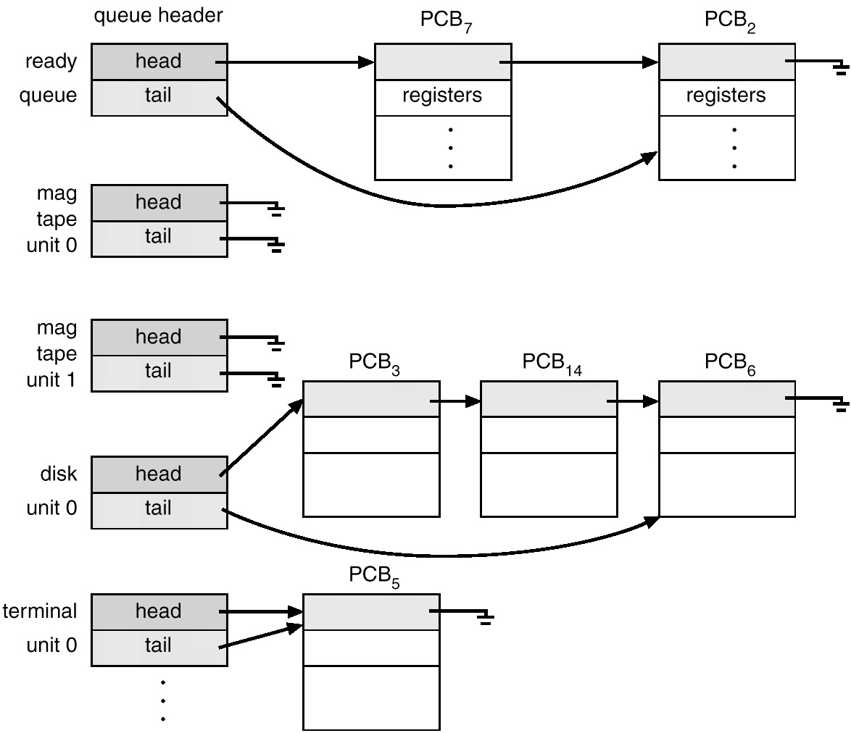
Ready Queue And Various I/O Device Queues

Slide 17
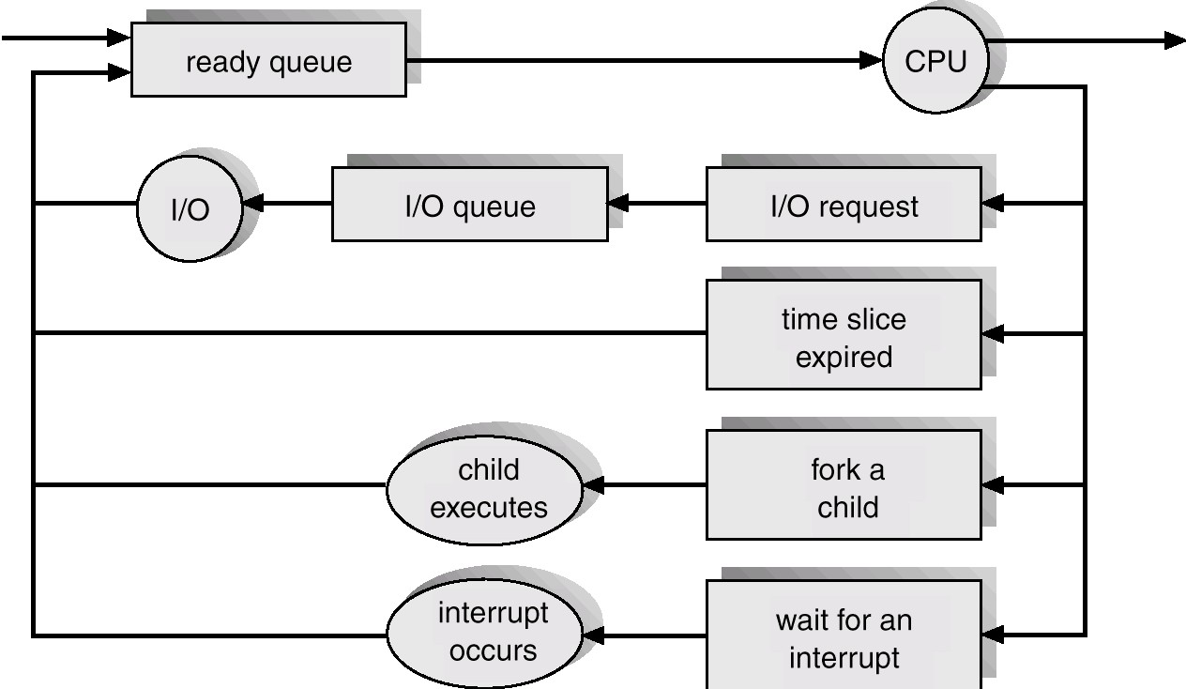
Representation of Process Scheduling

Slide 18
Schedulers
Long-term scheduler (or job scheduler) – selects which processes should be brought into the ready queue.
Short-term scheduler (or CPU scheduler) – selects which process should be executed next and allocates CPU.

Slide 19
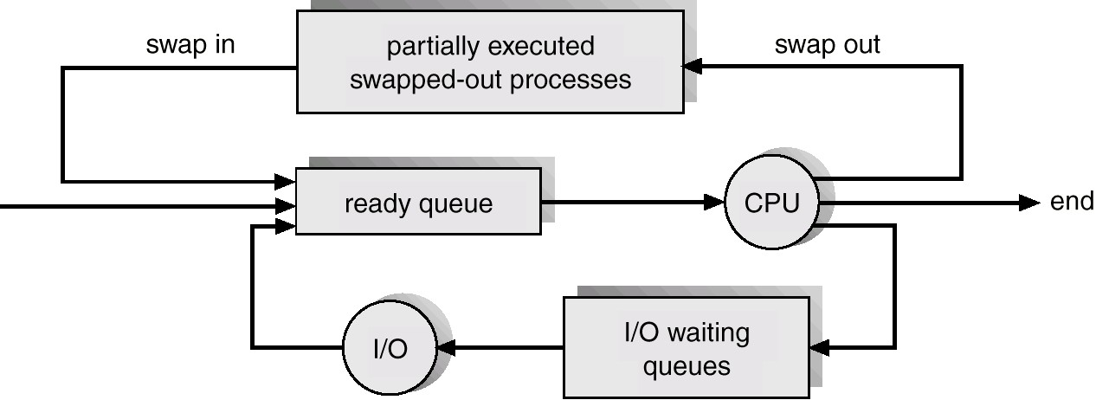
Addition of Medium Term Scheduling

Slide 20
Schedulers (Cont.)
Short-term scheduler is invoked very frequently (milliseconds) ⇒ (must be fast).
Long-term scheduler is invoked very infrequently (seconds, minutes) ⇒ (may be slow).
The long-term scheduler controls the degree of multiprogramming.

Slide 21
Scheduling Algorithms
The goal of scheduling algorithm is to identify the process whose selection will result in the “best” possible system performance.
A major division among scheduling algorithms is that whether they support pre- emptive or non-preemptive scheduling discipline.

Slide 22
Preemptive Scheduling
Preemption means the operating system moves a process from running to ready without the process requesting it.
Round Robin scheduling, priority based scheduling or event driven scheduling are considered to the preemptive scheduling algorithms.

Slide 23
Non- Preemptive scheduling
A scheduling discipline is non-preemptive if once a process has been allotted to the CPU, the CPU cannot be taken away from the process.
First come first served (FCFS), Shortest job first (SJF), Shortest Remaining time first (SRTF) are considered to be the non preemptive scheduling algorithms.

Slide 24
Interprocess Communication (IPC)
Mechanism for processes to communicate and to synchronize their actions.
Message system – processes communicate with each other without resorting to shared variables.
IPC facility provides two operations:
send(message) – message size fixed or variable
receive(message)

Slide 25
Contd…
If P and Q wish to communicate, they need to:
establish a communication link between them
exchange messages via send/receive
Implementation of communication link
physical (e.g., shared memory, hardware bus)
logical (e.g., logical properties)

Slide 26
Implementation Questions
How are links established?
Can a link be associated with more than two processes?
How many links can there be between every pair of communicating processes?
What is the capacity of a link?
Is the size of a message that the link can accommodate fixed or variable?
Is a link unidirectional or bi-directional?

Slide 27
Direct Communication
Processes must name each other explicitly:
send (P, message) – send a message to process P
receive(Q, message) – receive a message from process Q

Slide 28
Contd…
Properties of a communication link
Links are established automatically.
A link is associated with exactly one pair of communicating processes.
Between each pair there exists exactly one link.
The link may be unidirectional, but is usually bi-directional.

Slide 29
Indirect Communication
Messages are directed and received from mailboxes (also referred to as ports).
Each mailbox has a unique id.
Processes can communicate only if they share a mailbox.

Slide 30
Contd…
Properties of communication link
Link established only if processes share a common mailbox
A link may be associated with many processes.
Each pair of processes may share several communication links.
Link may be unidirectional or bi-directional.

Slide 31
Indirect Communication
Operations
create a new mailbox
send and receive messages through mailbox
destroy a mailbox
Primitives are defined as:
send(A, message) –
send a message to mailbox A
receive(A, message) – receive a message
from mailbox A

Slide 32
Indirect Communication
Mailbox sharing
P₁, P₂, and P₃ share mailbox A.
P₁, sends; P₂ and P₃ receive.
Who gets the message?

Slide 33
Contd…
Solutions
Allow a link to be associated with at most two processes.
Allow only one process at a time to execute a receive operation.
Allow the system to select arbitrarily the receiver. Sender is notified who the receiver was.

Slide 34
Synchronization
Message passing may be either blocking or non-blocking.
Blocking is considered synchronous
Non-blocking is considered asynchronous
send and receive primitives may be either blocking or non-blocking.

Slide 35
Buffering
Queue of messages attached to the link; implemented in one of three ways.
Zero capacity – 0 messages
Sender must wait for receiver (rendezvous).
Bounded capacity – finite length of n messages Sender must wait if link full.
Unbounded capacity – infinite length Sender never waits.

